Slide 1
Aligning holistic, person centred inclusion and wellbeing with an organisational culture of psychological safety and accountability to support personal and organisational resilience
Tuesday, 15 November 2022
1.25pm-1.55pm
Ayo Barley - Programme Director, EDI and Wellbeing
David Benson - OD Programme Director

Slide 2

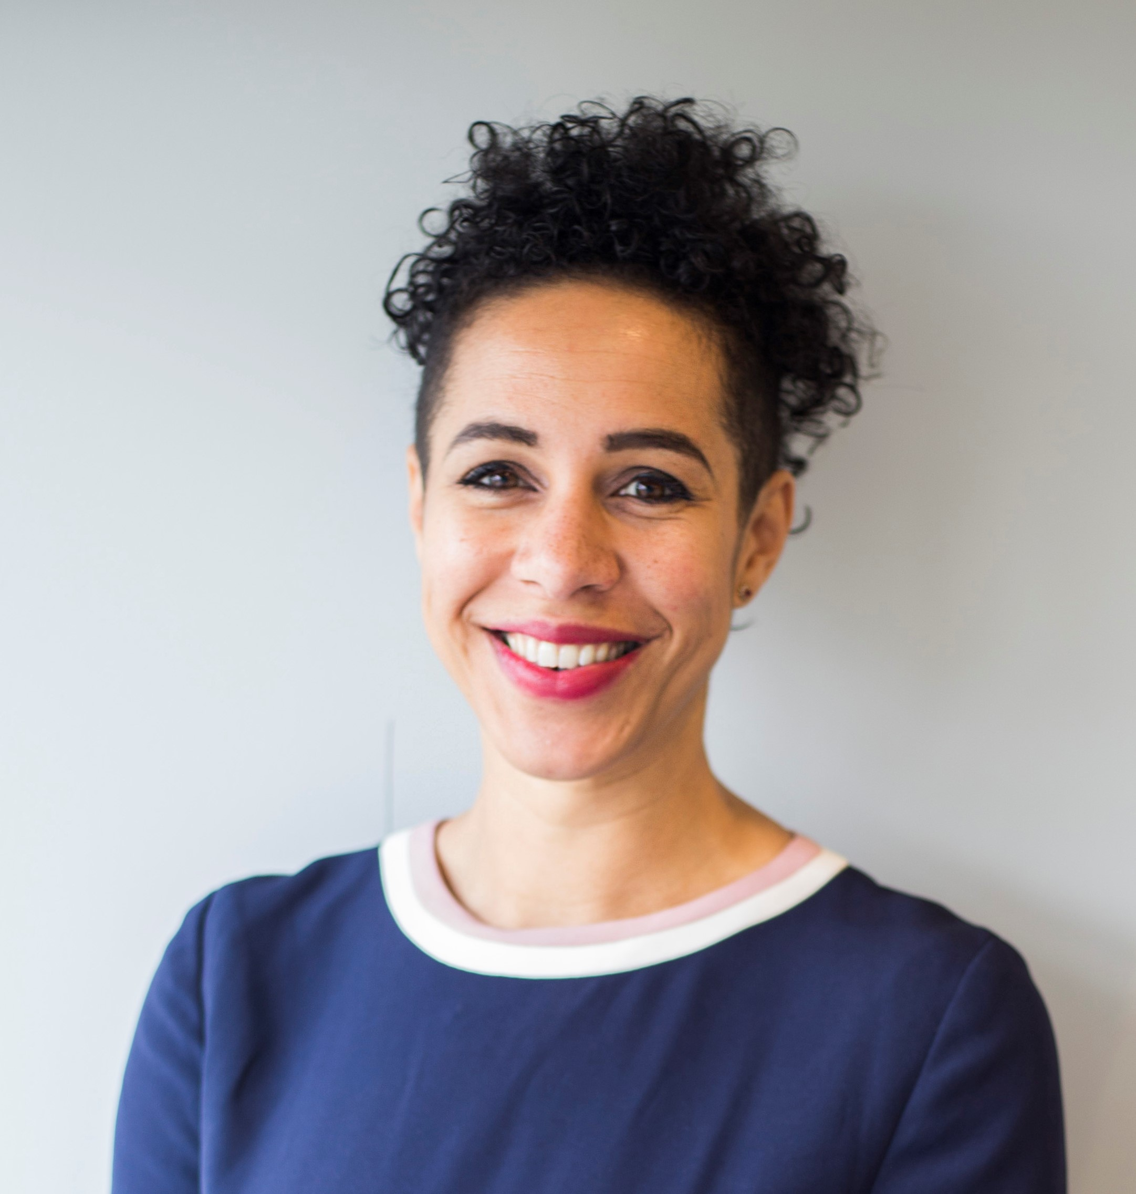
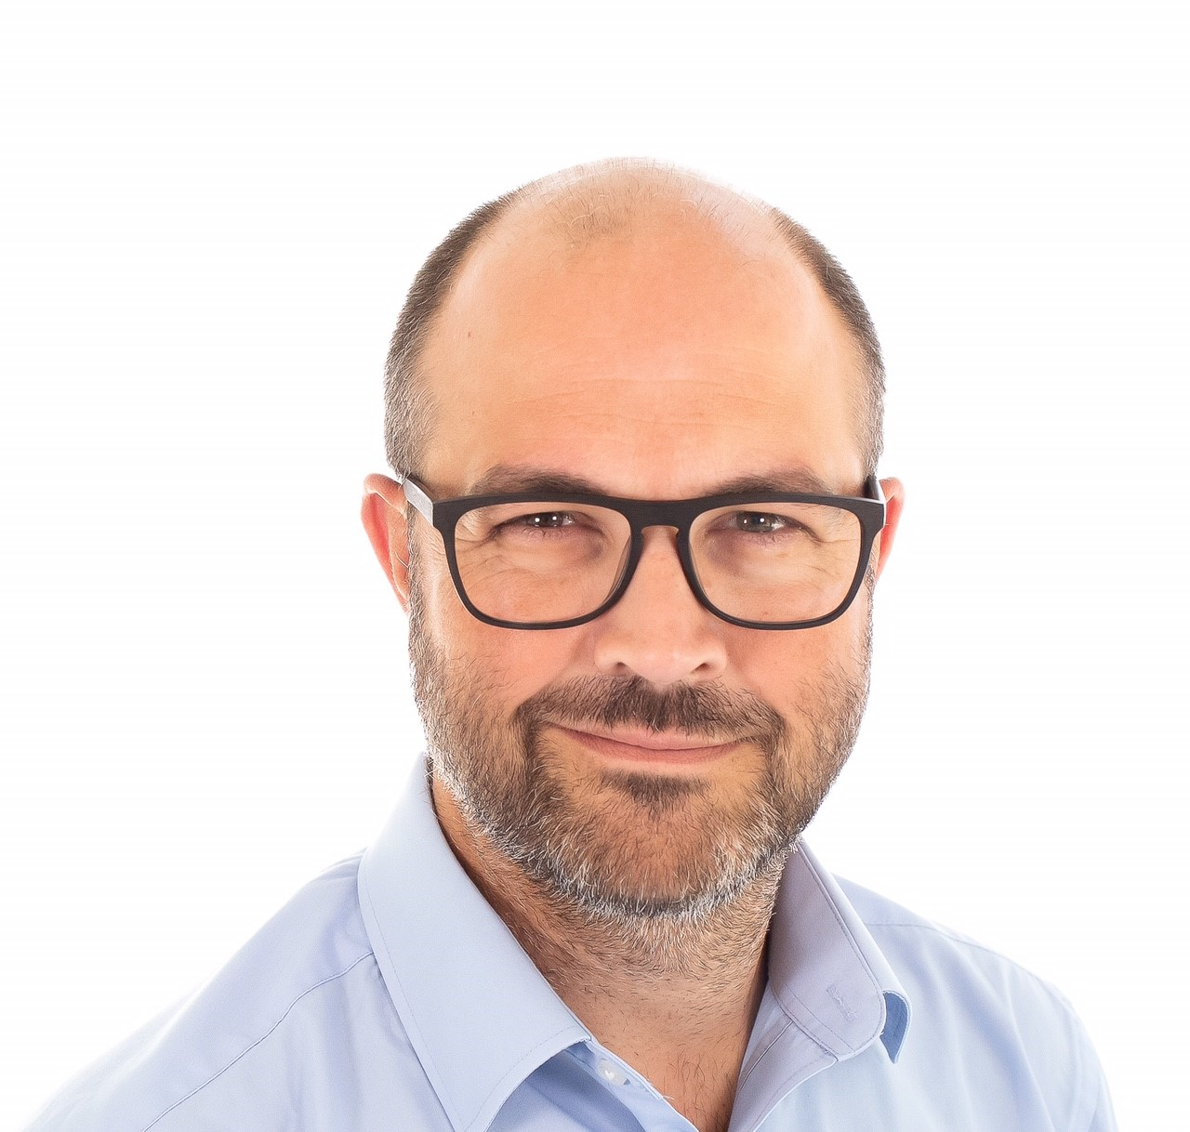
Welcome
What we’ll be covering today…
Our increasingly VUCA world
The ED&I Challenge and Building Resilience
Changing the conversation
Changing our approach
Creating space for ED&I and Resilience
Ayo Barley (She/her)
Equality, Diversity, Inclusion and Wellbeing Programme Director
David Benson
Organisational Development Programme Director

Slide 3
What IS going on?

Slide 4

It’s (still…) a VUCA World
Volatile
Uncertain
Complex
Ambiguous
Vision
Understanding
Clarity
Agility
Managing in a VUCA World

Slide 5
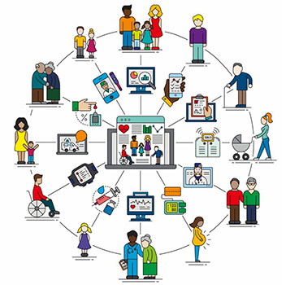
VUCA with an ED&I Lens
Murder of George Floyd
COVID-19
In 99.6% of NHS Trusts, a higher percentage of staff from the ‘Other’
ethnic group said they had experienced discrimination at work from
a colleague compared to White staff (WRES, 2020).
A report by the Nuffield Trust reported that discrimination and
other forms of unfair treatment are 'evident at every stage of the
career pipeline,' despite efforts over years to identify and eradicate
them (British Medical Journal, 2021).
And everyone's experience is different…
…and shapes their understanding and their ability to respond effectively
Notes:
We have seen disproportionate numbers of BAME doctors and other healthcare workers die from COVID-19: 21% of all staff are BAME – 63% of healthcare workers who died were BAME. 20% of nursing staff are BAME – 64% of nurses who died were BAME. 44% of medical staff are BAME – 95% of doctors who died were BAME

Slide 6
The Developmental Model of Intercultural Sensitivity (DMIS)
Integration
I communicate and work effectively with many cultural groups
Ethno-relative
Stages
Adaptation
I proactively use my knowledge about cultural differences to adapt my thinking and behaviour in culturally appropriate
Acceptance
Cultural differences exist, are important, and should be respected and valued
Ethnocentric
Stages
Minimisation
Differences between cultures are inconsequential
Defence
My culture is the true culture
Denial
Avoidance or separation from difference
Bennett, M.J. (1986). A developmental approach to training for intercultural sensitivity. International Journal of Intercultural Relations 10 (2), 179-95.

Slide 7
Why won’t everyone just do the right thing?

Slide 8

Perspective is Everything
People with protected characteristics have different lived experiences of the organisations around us
YOUR ORGANISATION ISN’T REAL
Your organisation is the story inside everyone’s head, they write it themselves and you have no direct control over it

Slide 9
Changing the conversation is everything

Slide 10
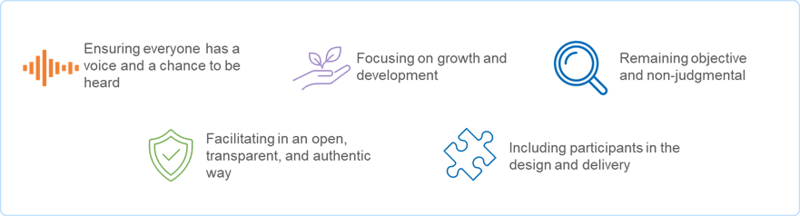
Creating Psychologically Safe Spaces
Notes:
Person centred for a psychologically safe space….
Couple of examples – BSW & Somerset…
Through 121s etc
Moving to brave spaces…

Slide 11
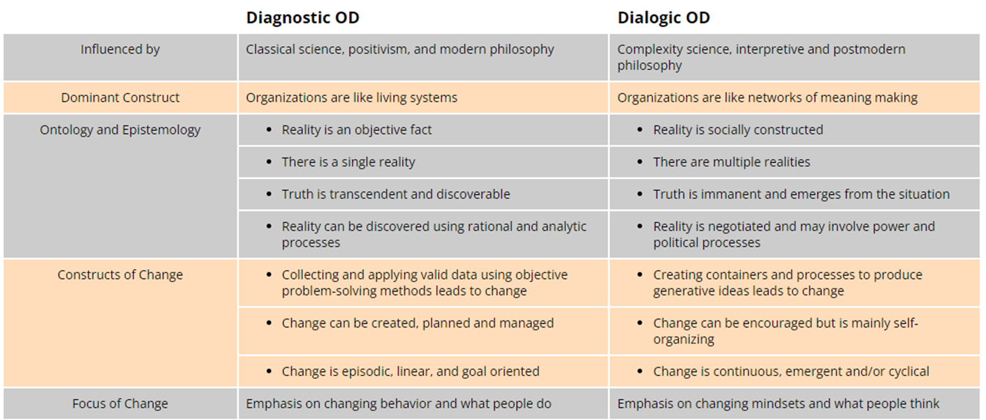
Shifting the Conversation: Diagnostic vs Dialogic Change

Slide 12
So what do we need to do differently?

Slide 13
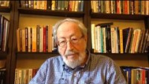
Edgar Schein – the Humble Consultant

Slide 14
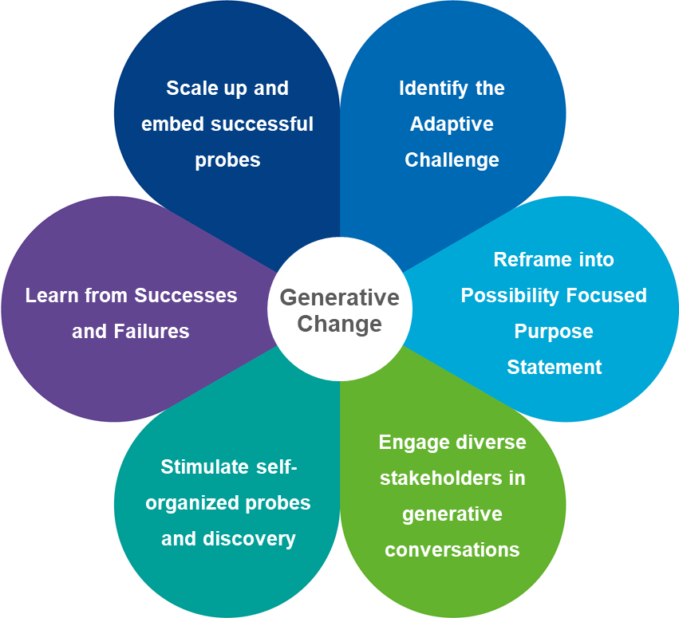
Doing Dialogic OD
“We do not see the world as it is…”
No longer solutions led… exploration and openness are the key
Creating the environment for honest dialogue
Focus on understanding and then disrupting the narratives espoused
People will lead the change themselves when the conditions for change are right

Slide 15
What does this mean for ED&I and Wellbeing

Slide 16

Creating the Right Climate
Get comfortable feeling uncomfortable
Create 'brave spaces' for discussions at all levels
Set targets, and don't let failure hold you back
Centre the voices of the most marginalised groups

Slide 17
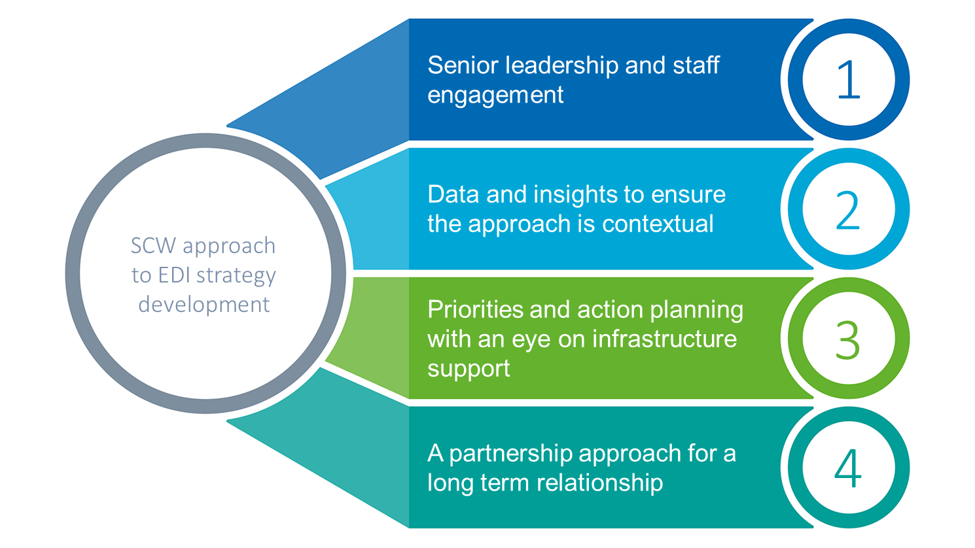
Building Resilience in EDI in a Trust Setting

Slide 18
Any questions, thoughts, or reflections?

